Slide 1


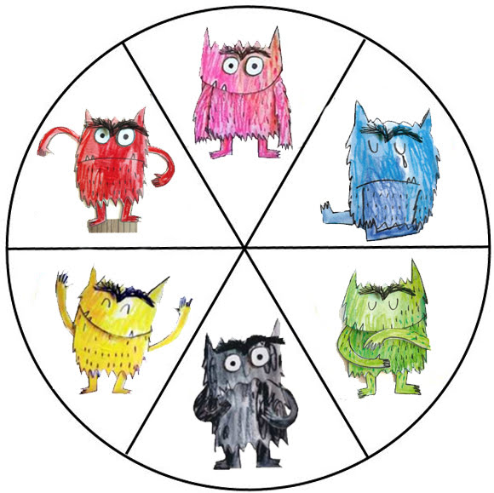

Compassion, Courage & Respect
My
Pupil Passport
Love
Angry
Sad
Happy
Calm
Scared
My name is:
My class is:
We are kind.
We are safe.
We are respectful.

Slide 2




I am good at:
I like:
I don’t like:
Things that help me:

Slide 3
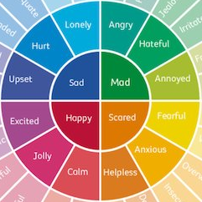
Compassion, Courage & Respect
My
Pupil Passport
My name is:
My class is:
We are kind.
We are safe.
We are respectful.

Slide 4


I am good at:
I am interested in:
I don’t like:
Things that help me:
I want you to know:
It would help me if you:

Slide 5
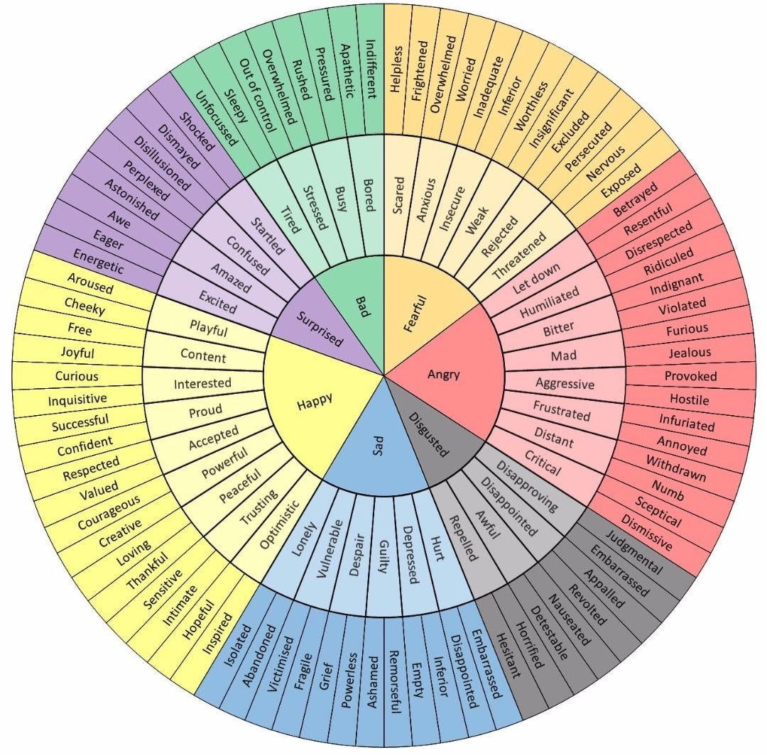
Compassion, Courage & Respect
My
Pupil Passport
My name is:
My class is:
We are kind.
We are safe.
We are respectful.

Slide 6
I am good at:
I am interested in:
I don’t like:
Things that help me:
I want you to know:
It would help me if you:

Slide 7

Pupil Passport
Child:____________________
Class:_____________________

Slide 8
Child Champion
I am:
I really like:
I would like you to know that:
These things make my lid flip:
It would help me if you could:
These things close my lid:

