Slide 1

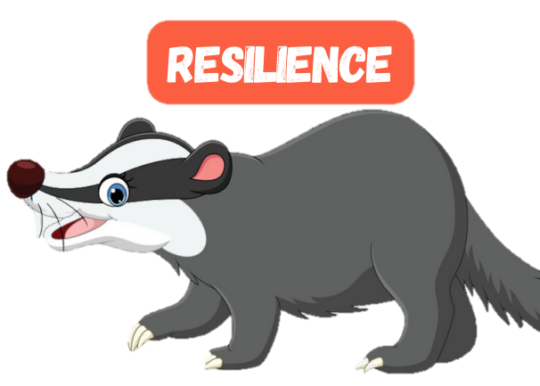



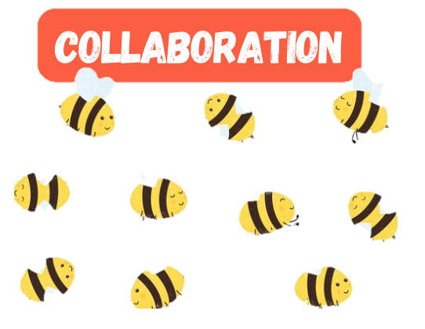



Welcome to
Sometimes, when you start something new, it is nice to find out some information before you begin. This book will show and tell you a little bit about Ladybird Class.
You have been given this book for a special reason. We are so pleased that you are joining Silchester School and we can’t wait to get to know you. We’re sure that we will have lots of fun learning and playing together.
Ladybird
Class

Slide 2
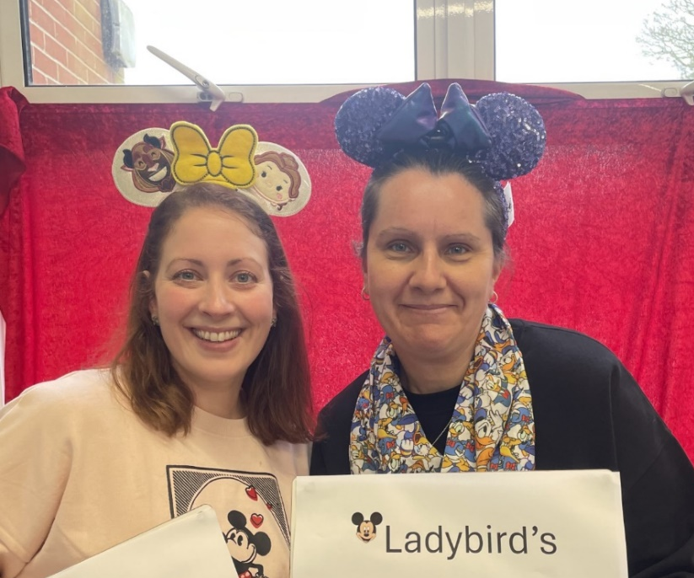
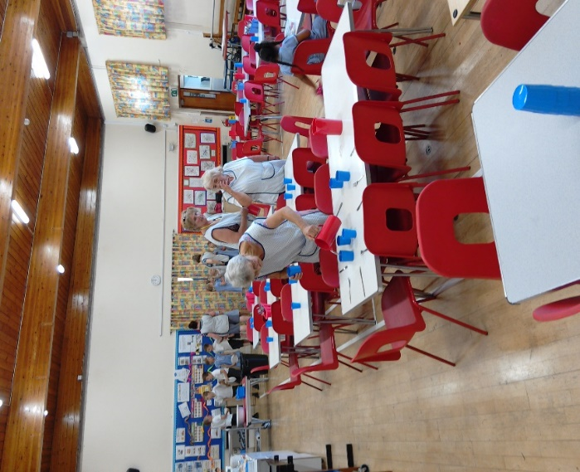
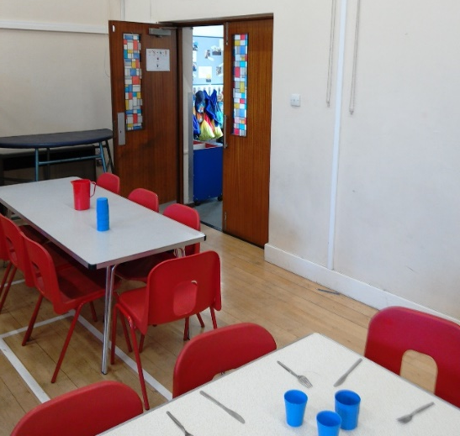
Your Teachers
Lunchtimes
We eat our lunch every day in the school hall.
We have our own tables, and a special dinner lady (called Mrs Hawkins) who helps us to collect our lunch and cut up our food.
After lunch, we play in our garden, and when we’re big enough, we can go to the playground.
These are your new teachers.
They are called Mrs Dowling and Mrs Heeks.
They are really kind and they can’t wait to meet you!

Slide 3
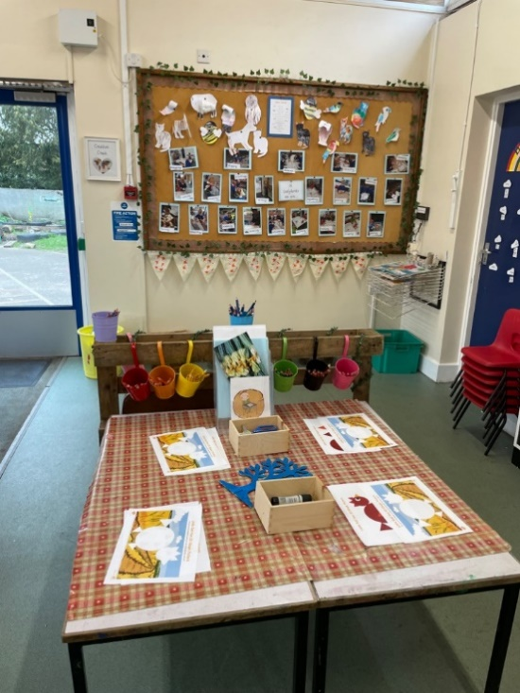
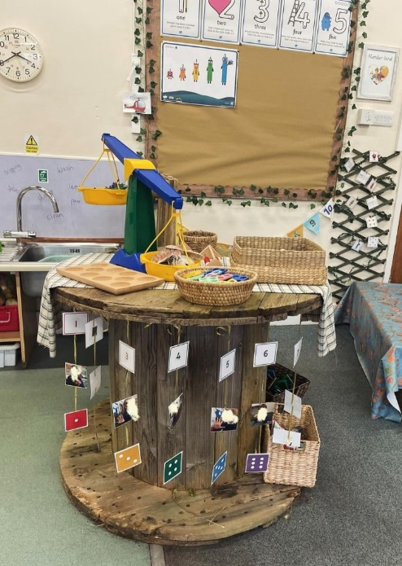
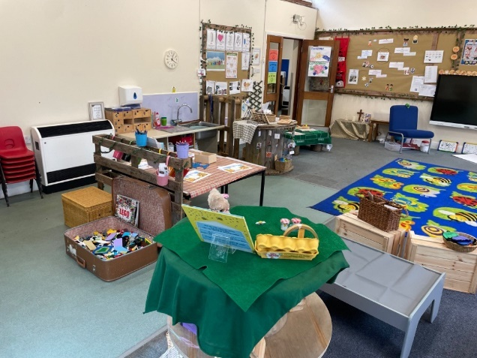
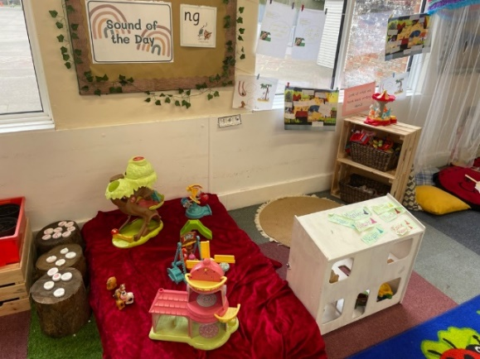
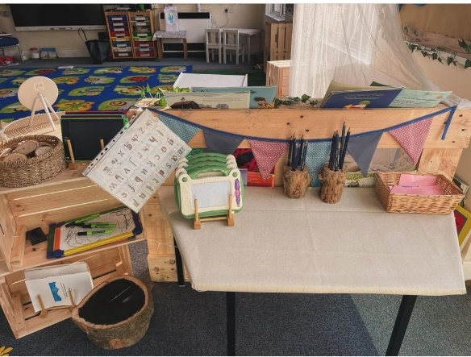
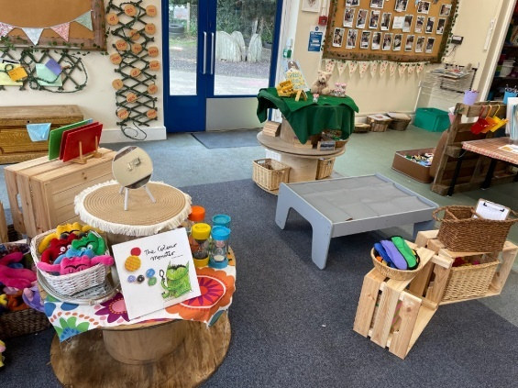
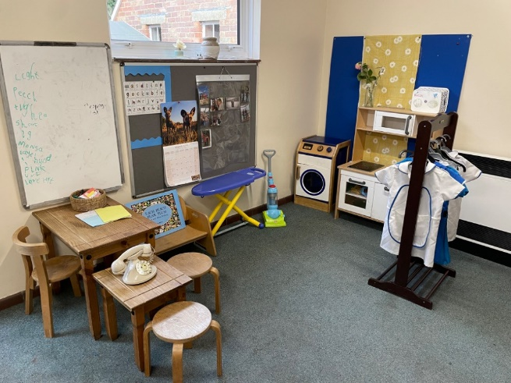
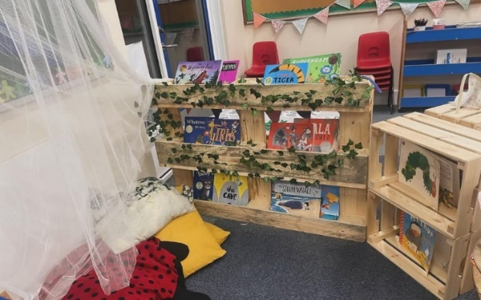
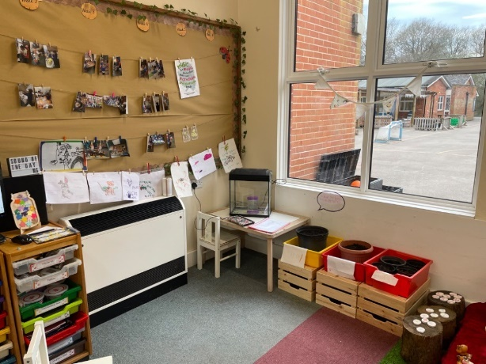
Your Classroom
This is your new classroom. There are different spaces for you to do art, reading, writing, maths, dressing up and lots of cosy corners for you to play with your friends.

Slide 4
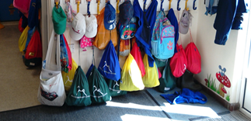
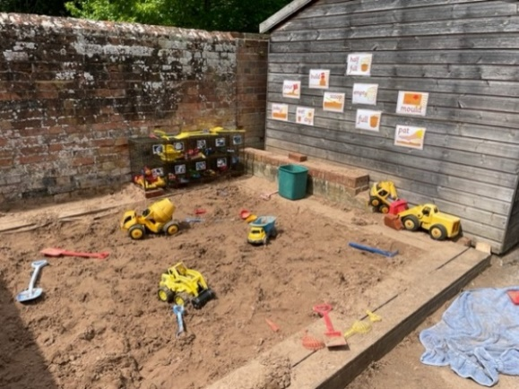
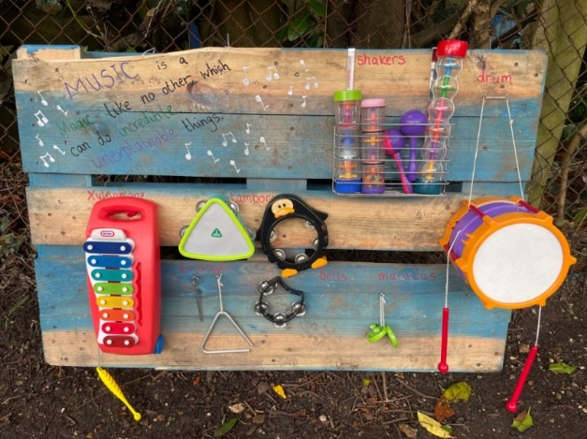
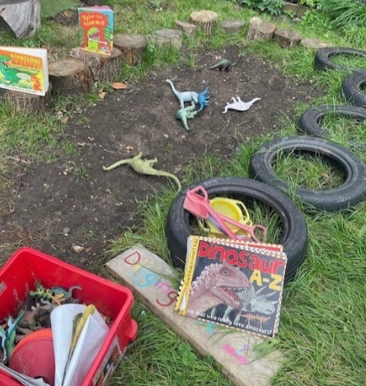
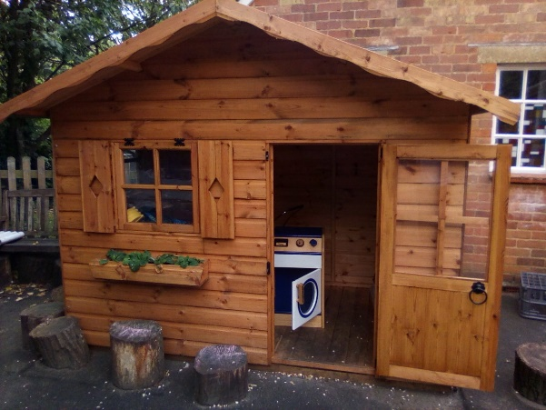
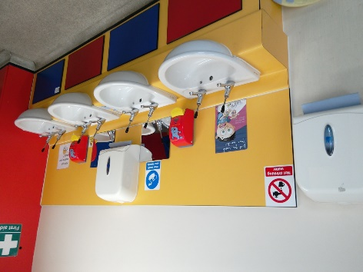
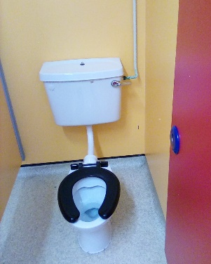
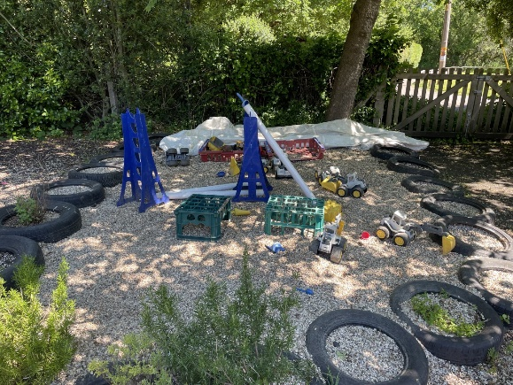
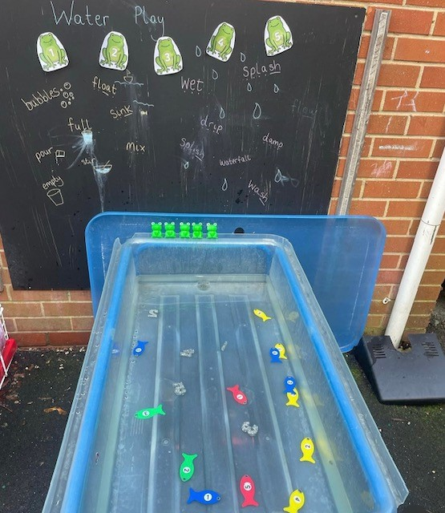
Your Cloakroom
Your Garden
We have our own garden to explore in…
You will have your own peg to hang your coat on.
We have our own set of sinks and toilets for you to use.

