Slide 1

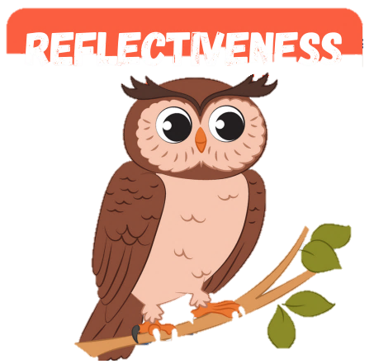
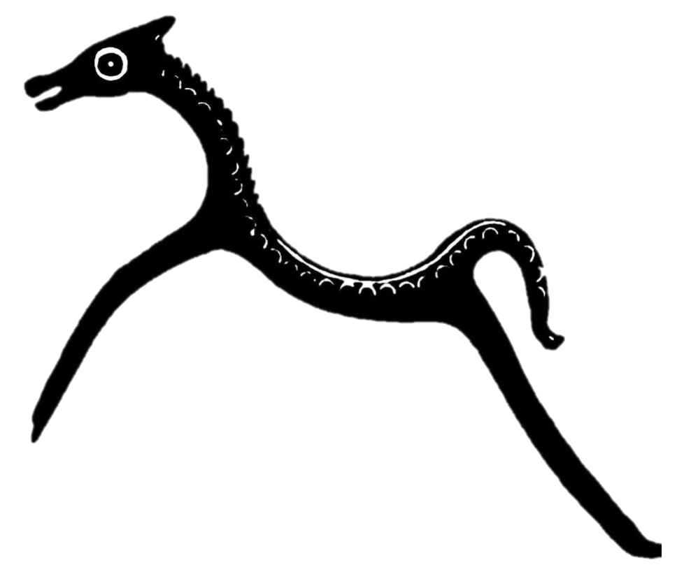
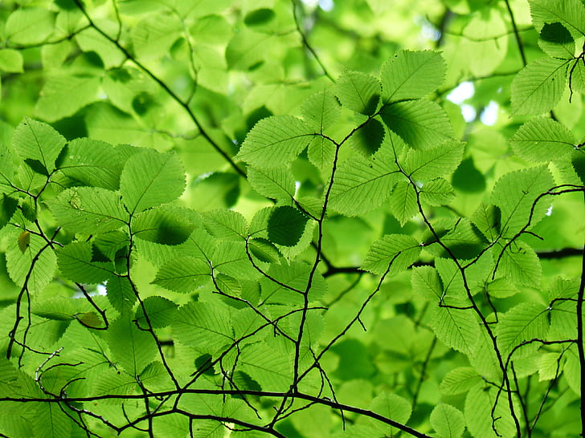
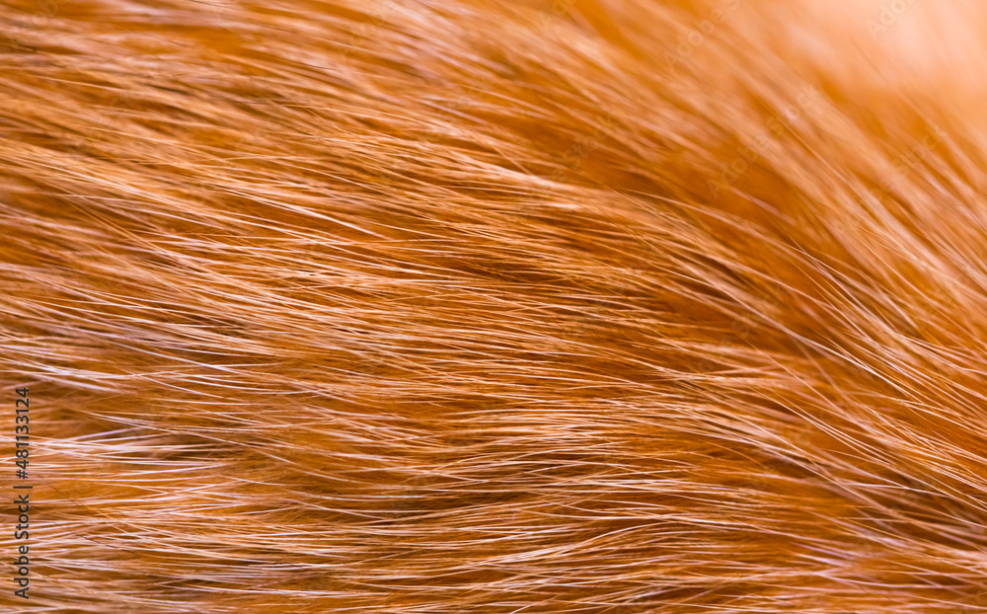
Animals
Silchester
Forest
The
of
Oscar the Reflective Owl

Slide 2
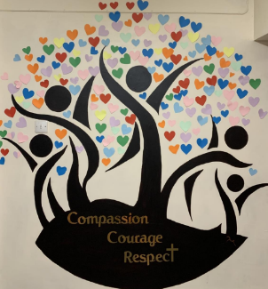
Our Vision
Our vision for Silchester is for everyone to flourish.
Our school is a place of love, of belonging and family.
We have a heart for people, inspiring everyone to be the best version of themselves:
for themselves, for others, for our community and for our world.
With our roots deeply embedded and nourished by our Christian values, we will thrive together.
We will reach out to each other, our community and the wider world with compassion in our hearts.
We will live bravely, showing courage to keep going when facing challenge.
We will respect ourselves and others, embracing everyone's unique gifts,
and value the contribution that we can all bring to God’s world.

Slide 3
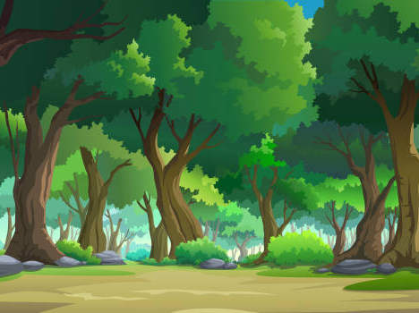
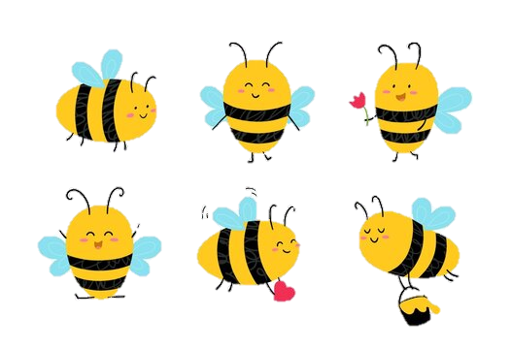
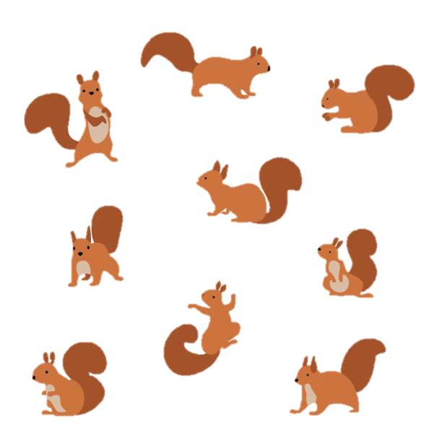
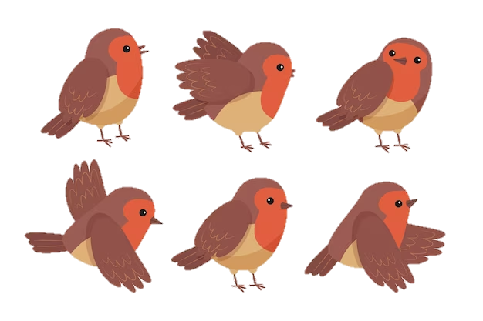
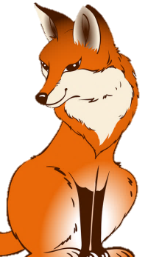
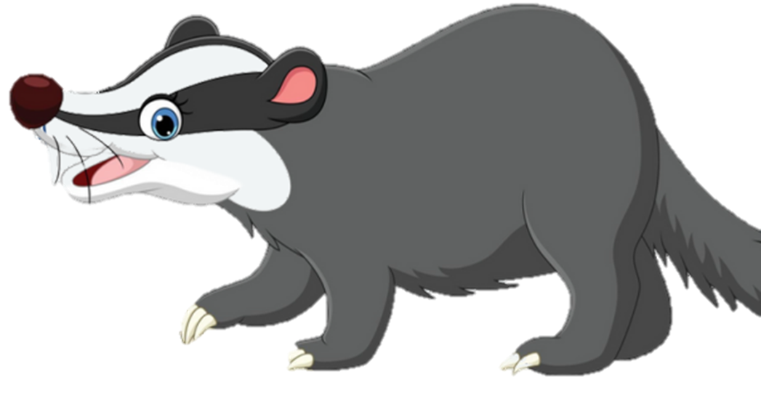
Deep in the heart of Silchester Forest…
Where the oak trees stand tall and the evergreens sway.
Where the gorse bushes prickle, and the silver birch shines.
Where the ground is soft with green bracken, mud, and moss.
Where the air is fresh and the pine needles perfume.
Where the birds sing their song, and the leaves play their tune.
Where red kites soar above and the cattle graze below.
Where the babbling brooks flow and the monkey bumps rise and fall…
Lives Oscar, the Reflective Owl.
Barnaby the Resilient Badger
However, he wasn’t always this way, let me tell you the story of how Oscar learnt to be reflective.

Slide 4
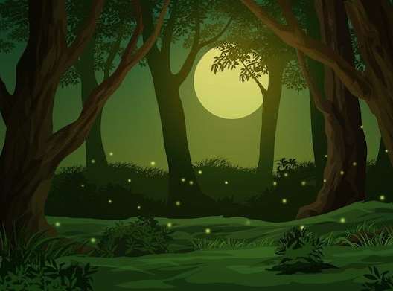

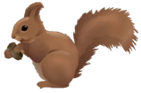
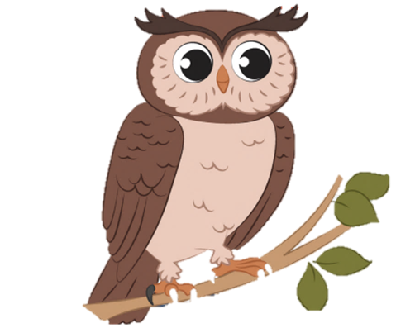
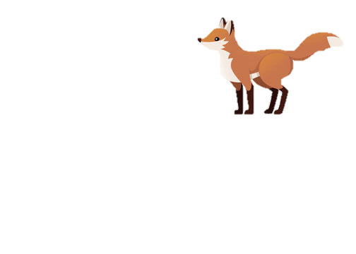
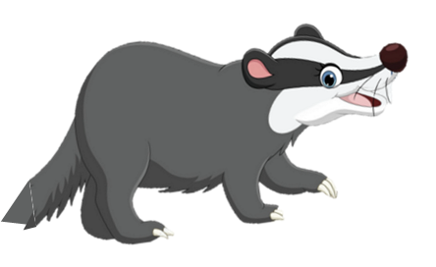
Oscar was a curious little fellow with big, bright eyes that sparkled like the stars above. Oscar loved to explore every nook and cranny of the forest, always eager to learn new things. One evening, as Oscar perched on a sturdy branch, he watched the other creatures of the forest going about their nightly routines. He saw the busy squirrels gathering nuts, a graceful fox tiptoeing through the trees, and a wise old badger slowly making his way across the forest floor. "What are they all doing?" Oscar wondered aloud.

Slide 5
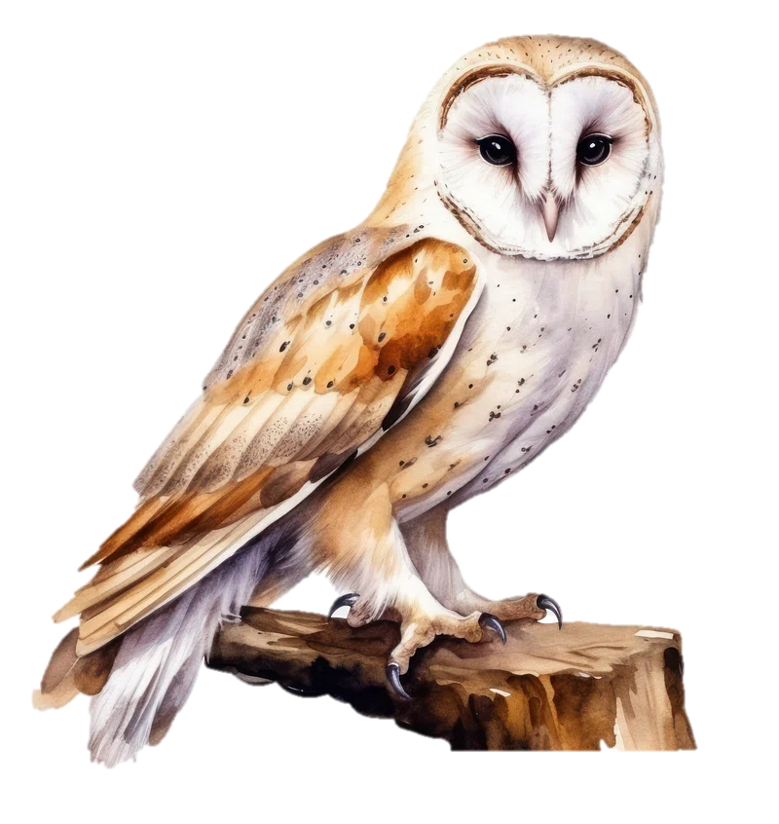
"They are living their lives, young Oscar," came a gentle voice from above. Startled, Oscar looked up to see a wise old owl named Orla gazing up at him with kind eyes. "Living their lives?" Oscar repeated, tilting his head in confusion. "Yes, my dear," Orla replied. "Each creature in this forest has its own way of living and learning. But there is something special about being an owl like you and me." "What's that?" Oscar asked, fluttering down to perch beside Orla.

Slide 6
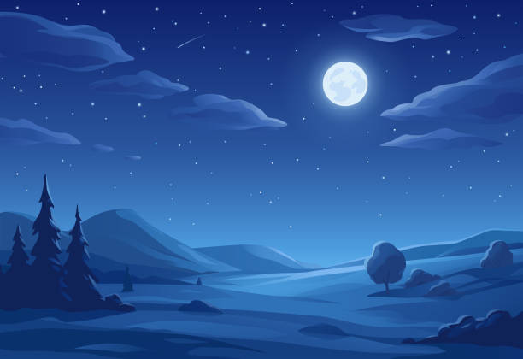
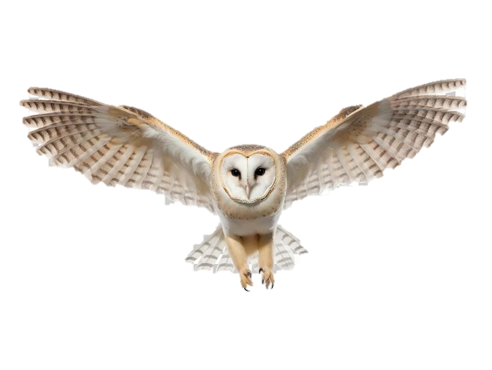
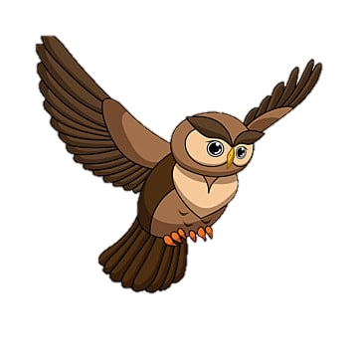
"We are creatures of the night, Oscar," Orla explained. "We see things that others cannot, and we have the gift of reflection."
"Reflection?" Oscar echoed; his curiosity piqued. "Yes, reflection," Orla nodded. "It means looking inward, thinking deeply about our thoughts and actions, and learning from them."
Oscar pondered Orla's words for a moment before asking, "But how do I learn to be reflective?" "It takes time and practice, young one," Orla said, ruffling her feathers. "But I believe you have the potential to become a truly wise owl."

Slide 7

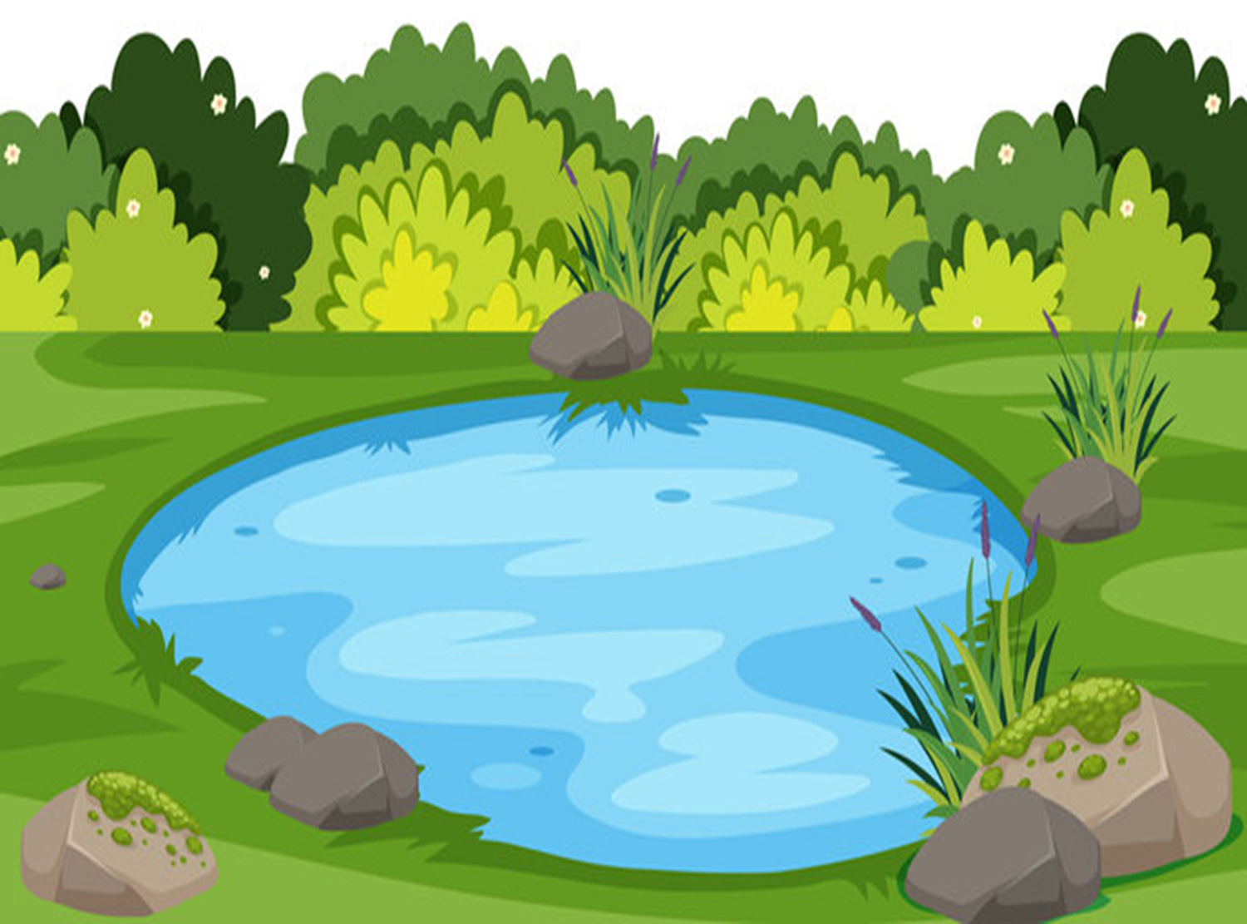

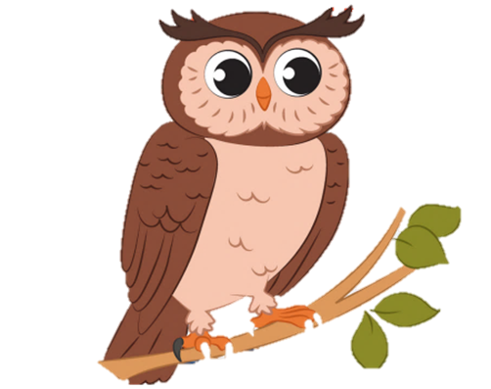
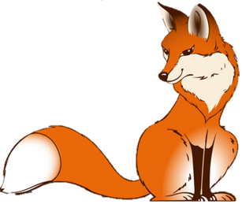
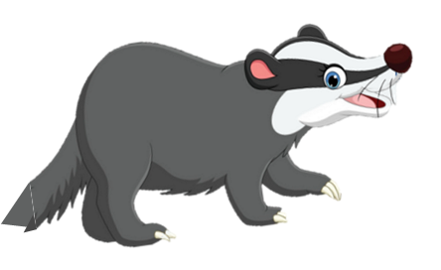



Determined to learn this new skill, Oscar set out into the forest each night, seeking moments of quiet reflection. He perched high in the trees, gazing up at the twinkling stars, and listened to the gentle rustle of the leaves below. He thought about his day, his encounters with other creatures, and the choices he had made.

Slide 8
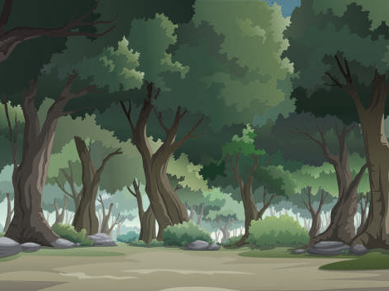
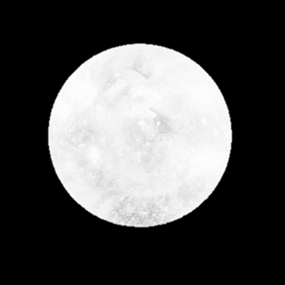
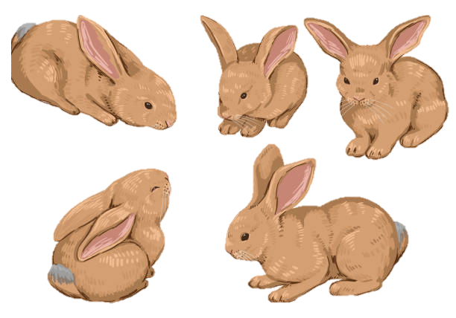
As the nights passed, Oscar began to notice a change within himself. He felt more aware of his thoughts and emotions, and he started to understand the importance of reflection in his life.
One night, as Oscar sat atop his favourite branch, he saw a family of rabbits scampering through the moonlit glade below. Suddenly, he had an idea.
"Orla!" Oscar called out, spreading his wings and taking flight.

Slide 9

Within moments, Orla appeared beside him, her feathers ruffled from the wind. "What is it, Oscar?" she asked, her wise eyes twinkling in the moonlight. "I've learned how to be reflective, just like you said!" Oscar exclaimed. "And I want to share this gift with others." Orla smiled proudly at Oscar, her heart swelling with joy. "Then go forth, young one," she said, her voice filled with wisdom. "Share your gift with the world and help others learn the power of reflection."

Slide 10
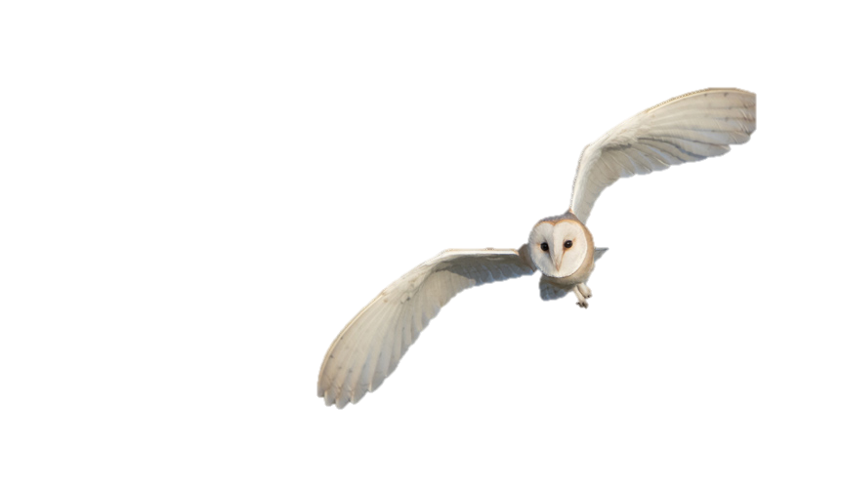


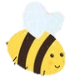
And so, with Orla's words ringing in his ears, Oscar soared through the forest, spreading his newfound wisdom to all who would listen. From that day forward, he was known as Oscar the Reflective Owl, beloved by all who knew him for his gentle spirit and his unwavering commitment to helping others learn and grow. And as the stars continued to twinkle in the night sky, Oscar knew that he had found his true purpose in life—to be a beacon of light in the darkness, guiding others on their journey of
self-discovery and reflection.
Reflectiveness
WELL DONE

Slide 11

Our Aim
Our aim is that the children of Silchester are confident in their own self-worth and resilient overcoming the obstacles they face. Their skills, learning, memories of experiences and positive relationships will empower them to contribute to the wider world and make a difference. We aim for our children to be lifelong learners who are grounded in our core Christian values of compassion, courage and respect, and ready to embrace their next step – whatever that may be.
.

Slide 12
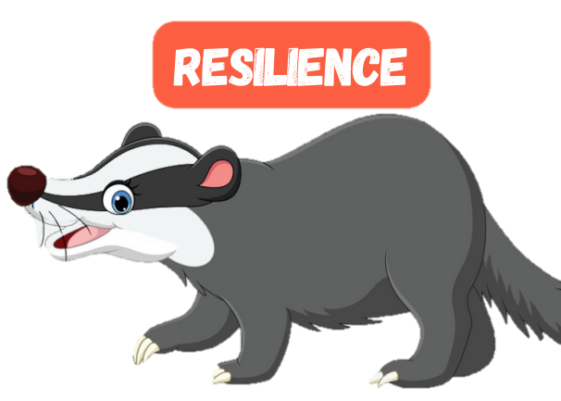
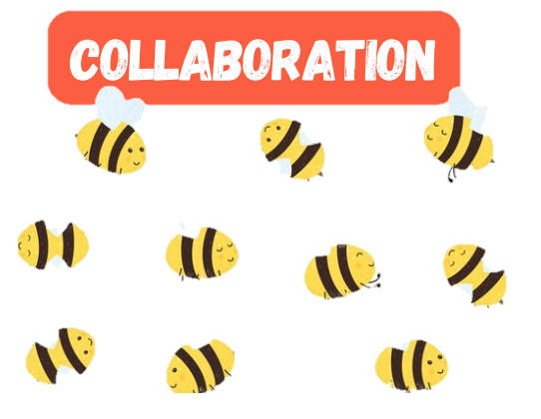

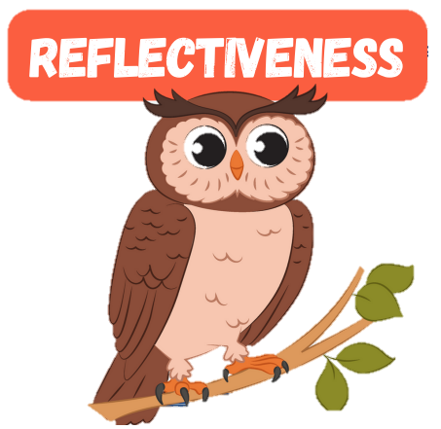

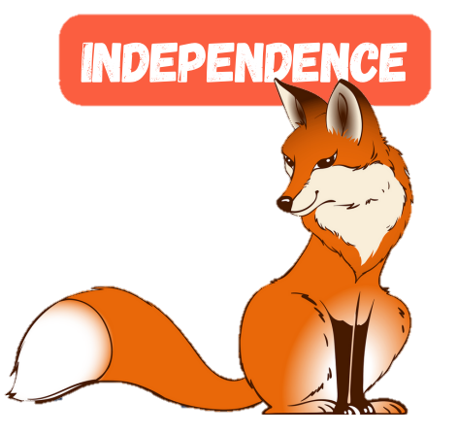
The
Animals
of
Silchester
Forest
teach us about the behaviours we need for learning.
In this book, we learn through the story of
Oscar the Reflective Owl.
Reflectiveness: We want our children to be thoughtful, considerate learners who ask themselves questions to challenge and support their progress. Reflecting on their own successes and failures and identifying how they can improve is an important part of lifelong learning.

