Slide 1

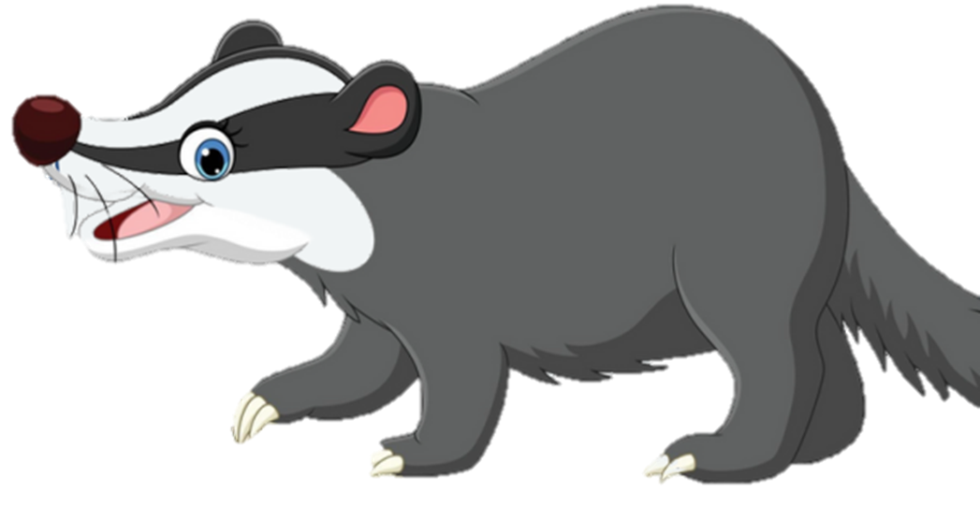
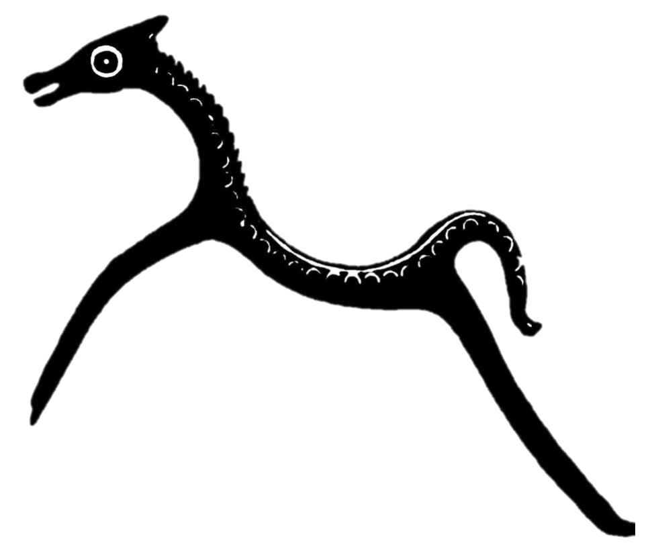
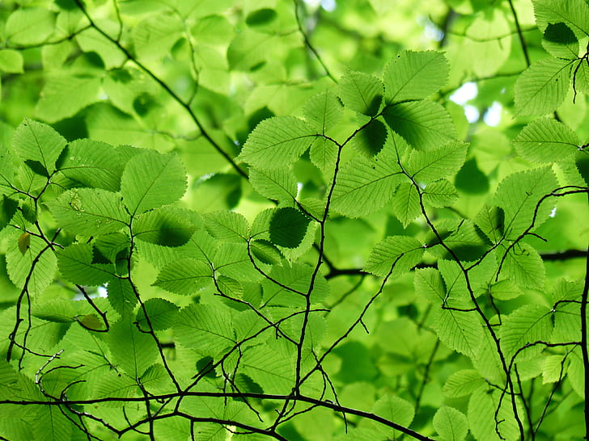
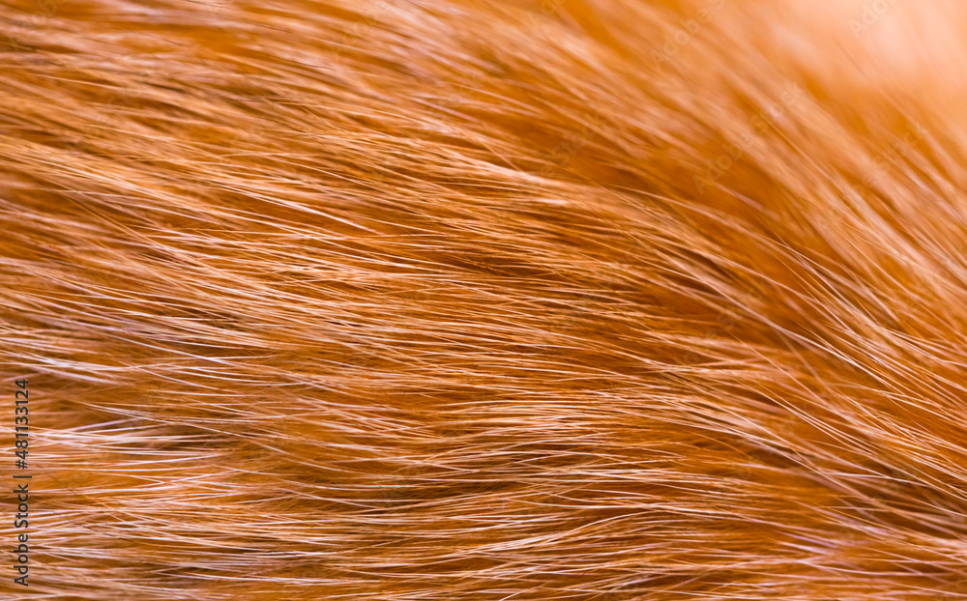
Animals
Silchester
Forest
The
of
Barnaby the Resilient Badger

Slide 2
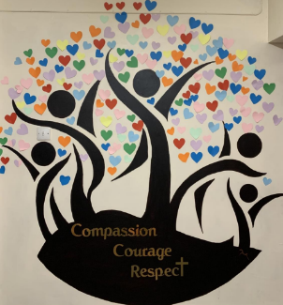
Our Vision
Our vision for Silchester is for everyone to flourish.
Our school is a place of love, of belonging and family.
We have a heart for people, inspiring everyone to be the best version of themselves:
for themselves, for others, for our community and for our world.
With our roots deeply embedded and nourished by our Christian values, we will thrive together.
We will reach out to each other, our community and the wider world with compassion in our hearts.
We will live bravely, showing courage to keep going when facing challenge.
We will respect ourselves and others, embracing everyone's unique gifts,
and value the contribution that we can all bring to God’s world.

Slide 3
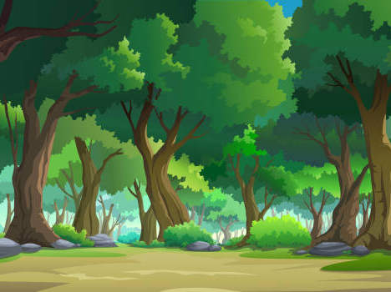
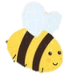
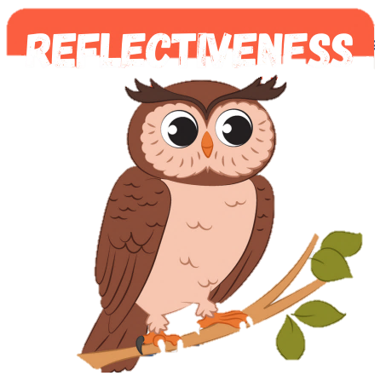
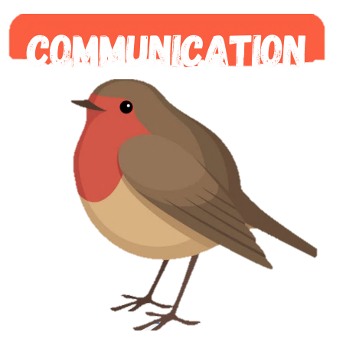
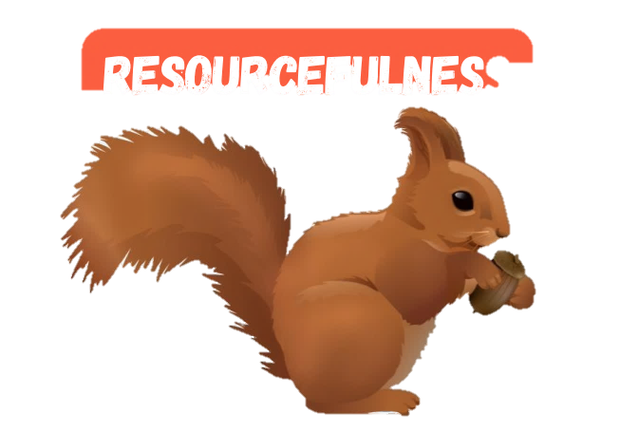
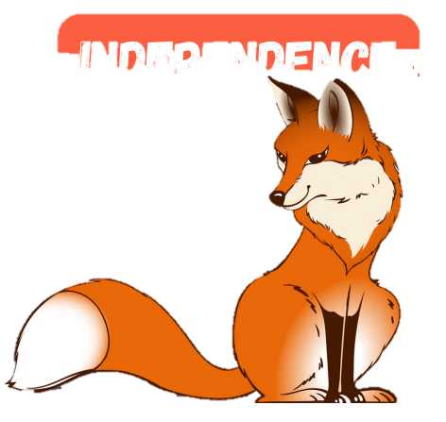
Deep in the heart of Silchester Forest…
Where the oak trees stand tall and the evergreens sway.
Where the gorse bushes prickle, and the silver birch shines.
Where the ground is soft with green bracken, mud, and moss.
Where the air is fresh and the pine needles perfume.
Where the birds sing their song, and the leaves play their tune.
Where red kites soar above and the cattle graze below.
Where the babbling brooks flow and the monkey bumps rise and fall…
Lives Barnaby, the Resilient Badger.
Barnaby the Resilient Badger
However, he wasn’t always this way, let me tell you the story of how Barnaby learnt to be resilient.

Slide 4
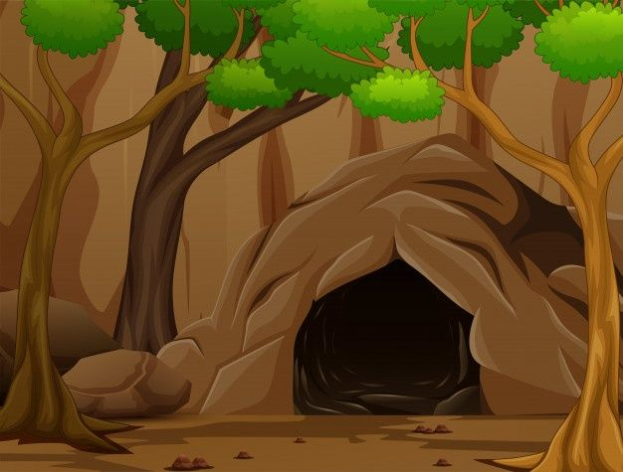
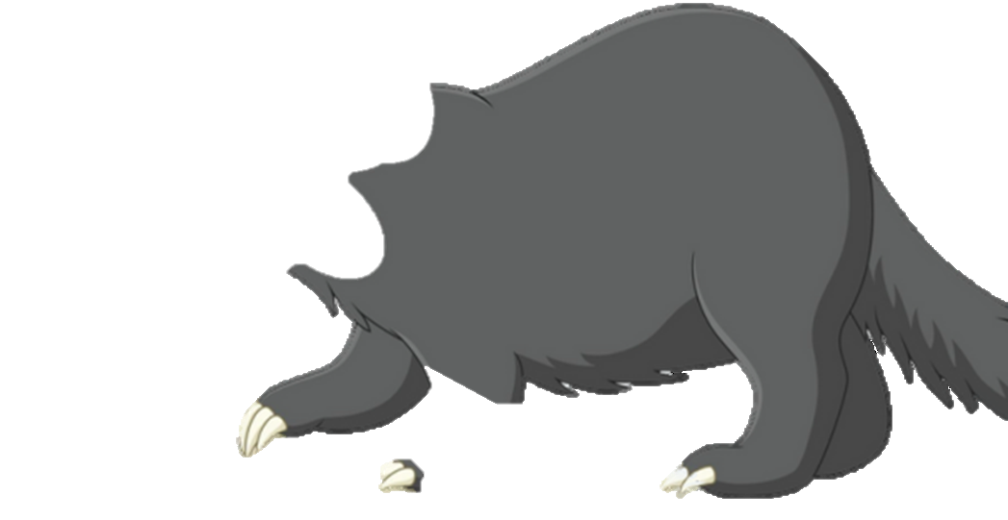
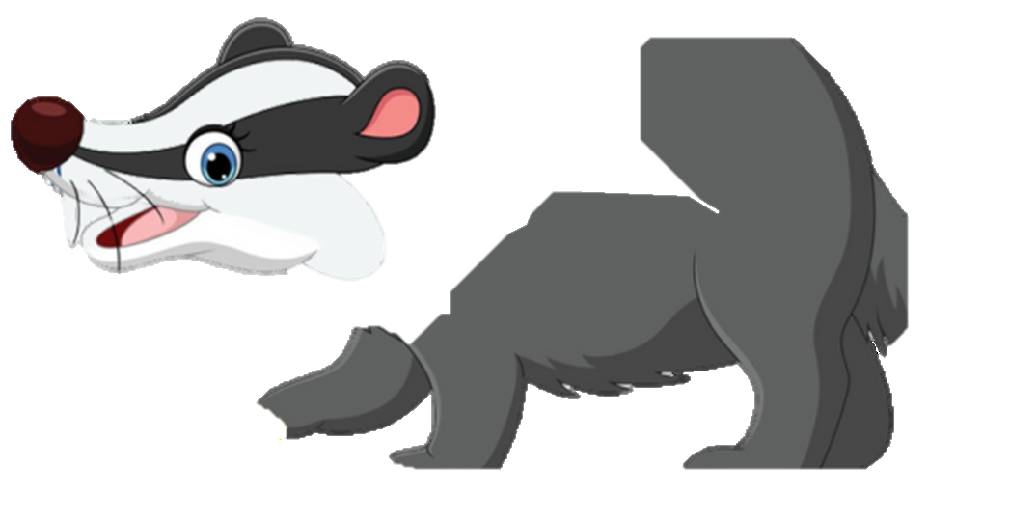
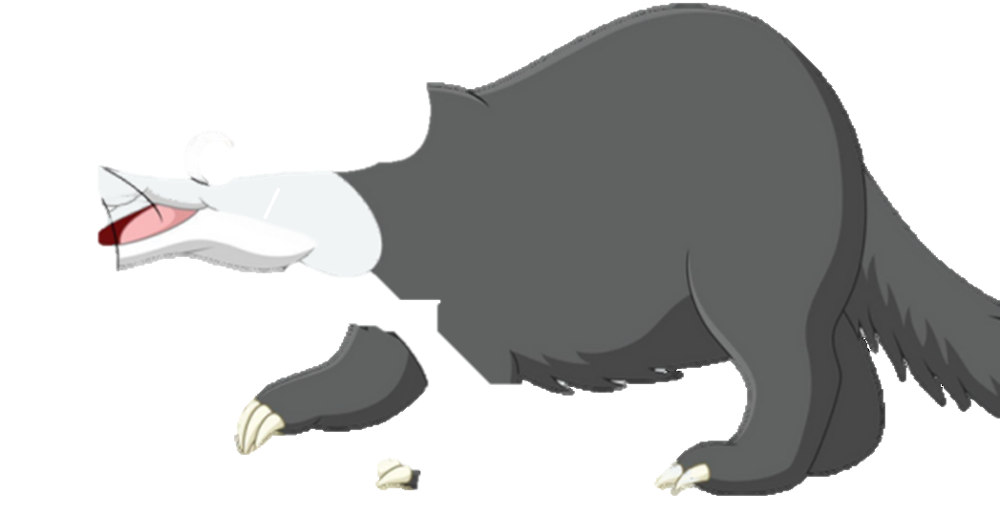
Barnaby was a curious and adventurous little badger who loved exploring every nook and cranny of Silchester Forest. However, Barnaby tended to give up easily when faced with challenges.

Slide 5
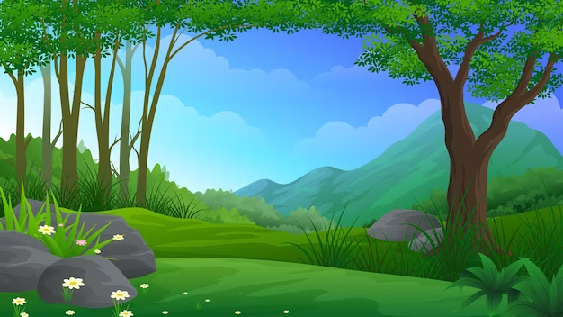

One sunny morning, Barnaby decided to venture deeper into the forest than he had ever gone before. As he trotted along, he stumbled upon a steep hill. Determined to reach the top, Barnaby began to climb. Up and up he went, but with each step, the hill seemed to grow steeper and taller, and Barnaby soon found himself struggling to continue.

Slide 6
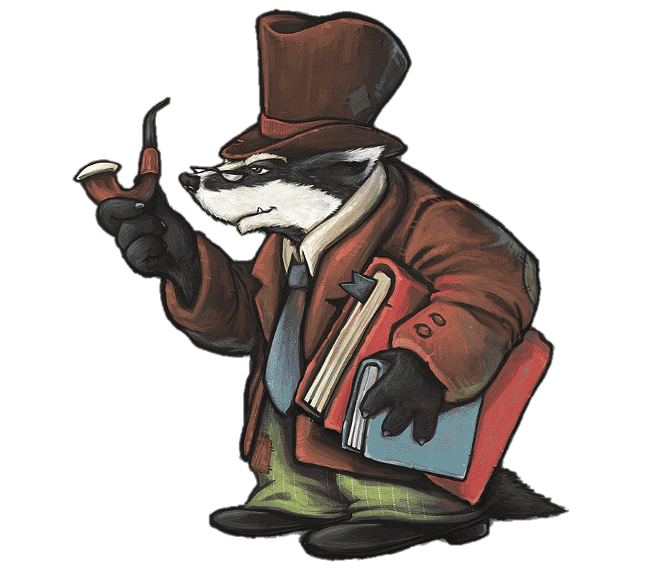
Feeling frustrated and defeated, Barnaby sat down at the base of the hill, ready to give up. But then, he remembered the wise words of Grandfather Badger: "In the face of adversity, be like the sturdy oak tree—bend but never break."

Slide 7
Inspired by Grandfather Badgers’ words, Barnaby took a deep breath and decided to try again. He approached the hill with a newfound determination, taking one step at a time, refusing to let the challenge overwhelm him. With each step, Barnaby grew stronger and more resilient, until at last, he reached
the top of the hill.

Slide 8

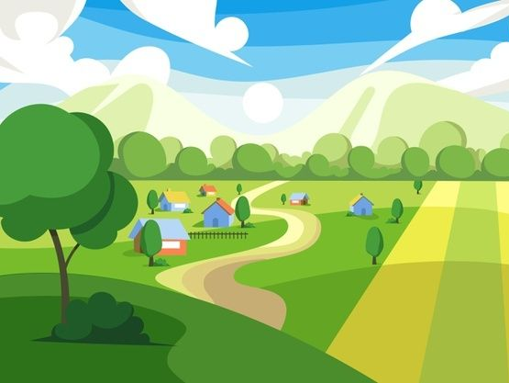

From the summit, Barnaby could see the entire forest spread out before him, bathed in the golden light of the setting sun. He felt a surge of pride and joy knowing that he had conquered the hill.

Slide 9
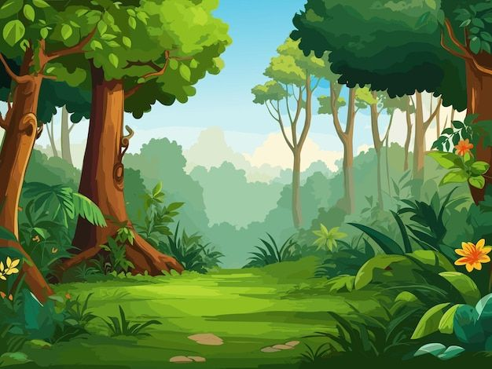
As Barnaby made his way back home, he realised that resilience was the key to overcoming obstacles, no matter how big or small. From that day on, whenever Barnaby faced a challenge, he remembered the lesson he had learned on the hillside and faced it with courage and determination.

Slide 10

And so, Barnaby the Brave Badger became known throughout Silchester Forest as a symbol of resilience and strength, inspiring all who knew him to never give up,
no matter what challenges they faced.
Barnaby the Resilient Badger
Resilience
WELL DONE

Slide 11

Our Aim
Our aim is that the children of Silchester are confident in their own self-worth and resilient overcoming the obstacles they face. Their skills, learning, memories of experiences and positive relationships will empower them to contribute to the wider world and make a difference. We aim for our children to be lifelong learners who are grounded in our core Christian values of compassion, courage and respect, and ready to embrace their next step – whatever that may be.
.

Slide 12
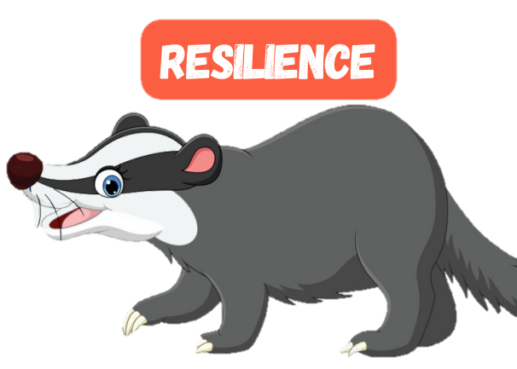
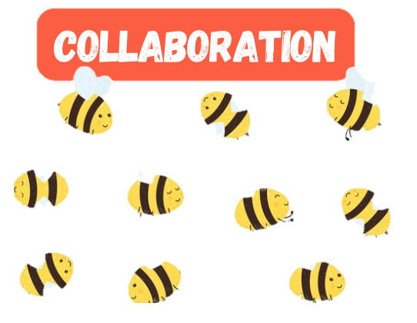
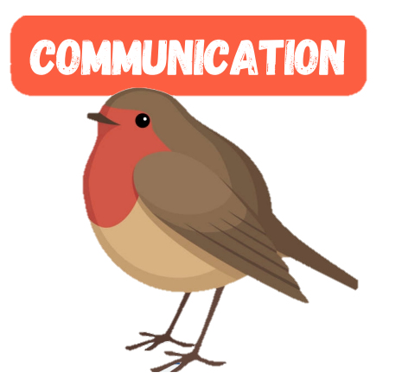
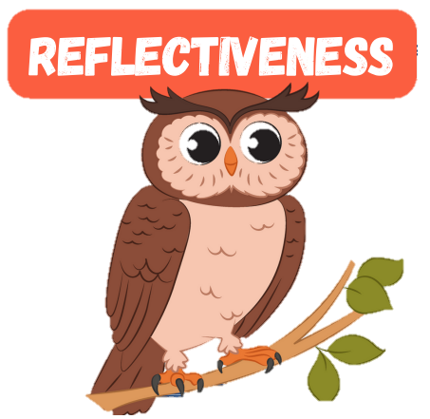
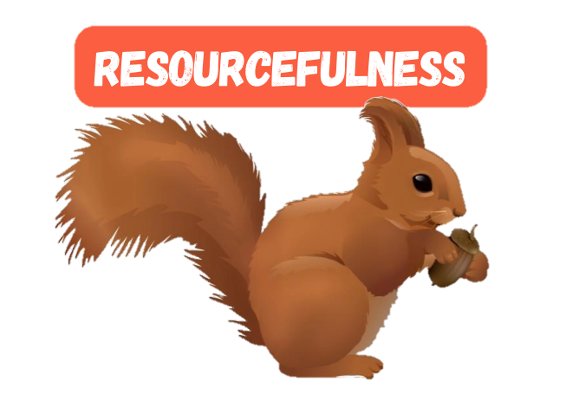
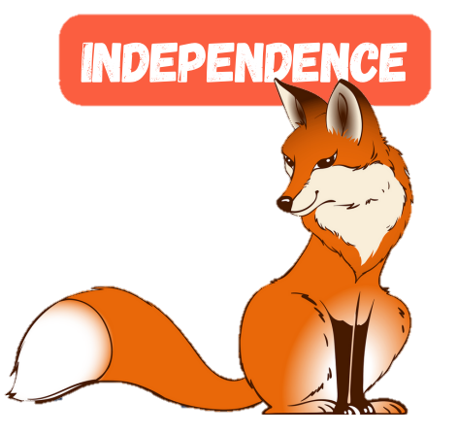
The
Animals
of
Silchester
Forest
teach us about the behaviours we need for learning.
In this book, we learn through the story of
Barnaby the Resilient Badger.
Resilience: We teach our children that resilience is the ability to bounce back after challenges, setbacks and tough times. Resilience develops when children experience difficulties and learn to deal with them positively. Just outside our comfort zone is where we learn best. We must be challenged in order to apply resilience and this perseverance is celebrated.

